Slide 1
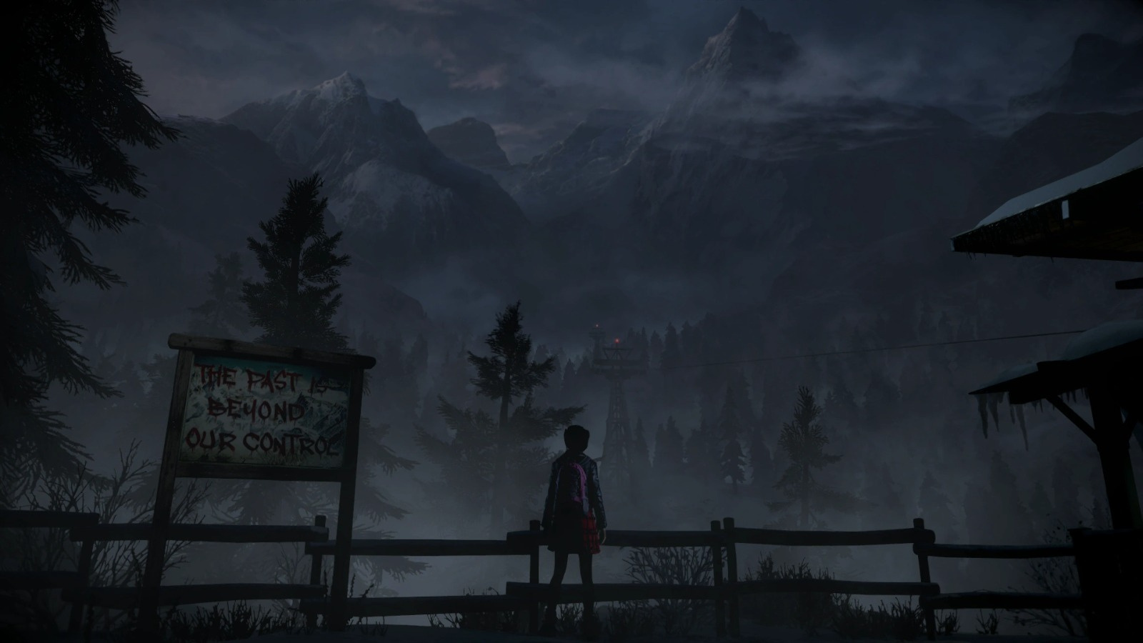
Until Dawn Wiki Website
Ezginur Yılmaz & İrem Demirtaş
User Interface Design and Testing

Slide 2
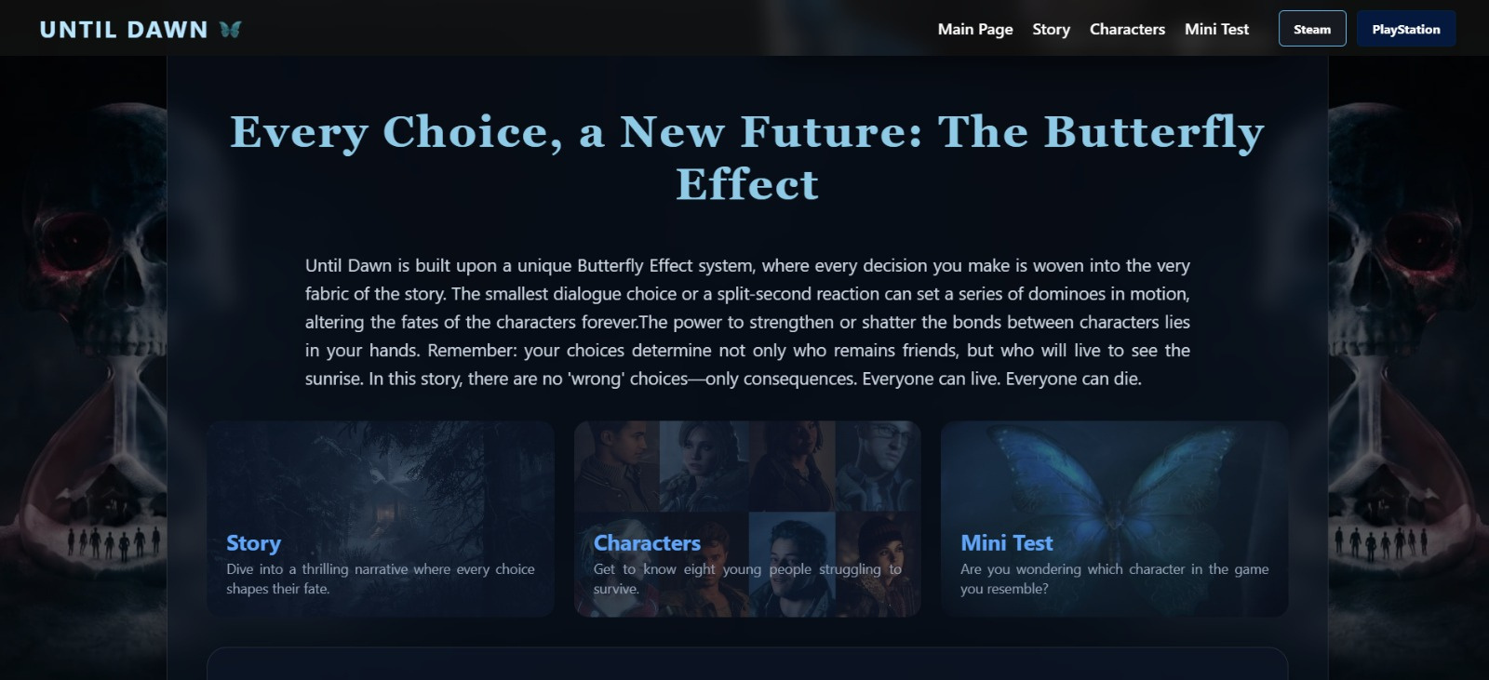
Overview
A dedicated web platform for fans to explore the dark and atmospheric world of Blackwood Pines.

Slide 3
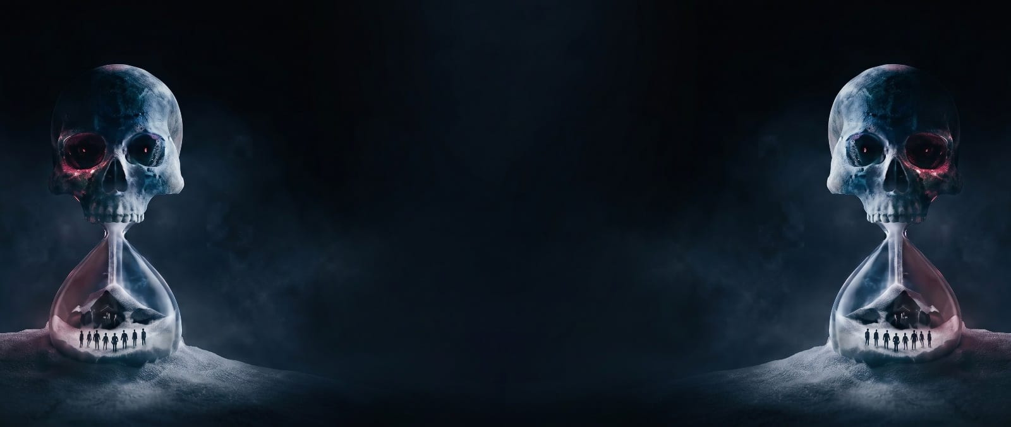
GOALS
To build an organized and reliable wiki-style platform that serves as a primary source for Until Dawn storylines and character backgrounds.
To design a dark-themed visual environment that reflects the game’s horror aesthetic while ensuring a clean and readable user interface.
To integrate a JavaScript-based quiz that tests users' knowledge of the game, mirroring the choice-based nature of the original story.

Slide 4
USER ANALYSİS & REQUİREMENTS
Target Audience
User Needs
Fans of horror and survival-drama games.
Fans of horror and survival-drama games.
Users interested in decision-based gameplay mechanics.
A single, well-structured place to access story summaries and character details.
An engaging way to see which game character aligns with their own traits and choices.
A visual design that keeps the user in the "horror" mindset while they browse.
The ability to move easily between the story, characters, and the quiz without confusion.

Slide 5

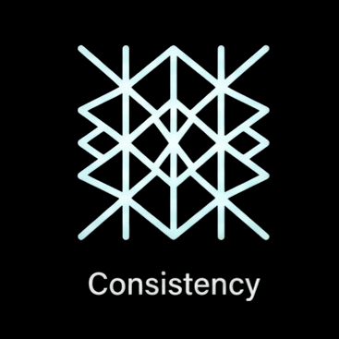
DESIGN PRINCIPLES
Simplicity
Avoiding cluttered layouts and focusing on high-quality visuals and essential text for better readability.
Consistency:
Maintaining a unified dark-themed aesthetic and a constant navigation bar across all four pages.

Slide 6
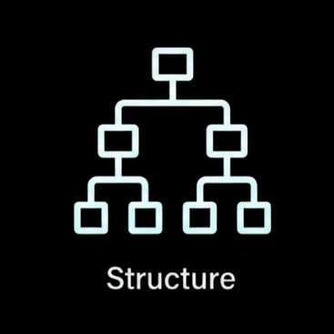

DESIGN PRINCIPLES
Structure:
Organizing information hierarchically, ensuring a logical flow from the main story to specific character details.
Feedback (Mini Test):
Providing immediate results in the personality quiz to confirm the user’s selection and match.

Slide 7


DEVELOPMENT PROCESS
Modular CSS Architecture:
Implementing a custom styling system to maintain the dark horror aesthetic across all pages while managing layout structures.
Dynamic JavaScript Interaction:
Developing a logic-based scoring system for the personality quiz to provide personalized character matches for the user.

Slide 8
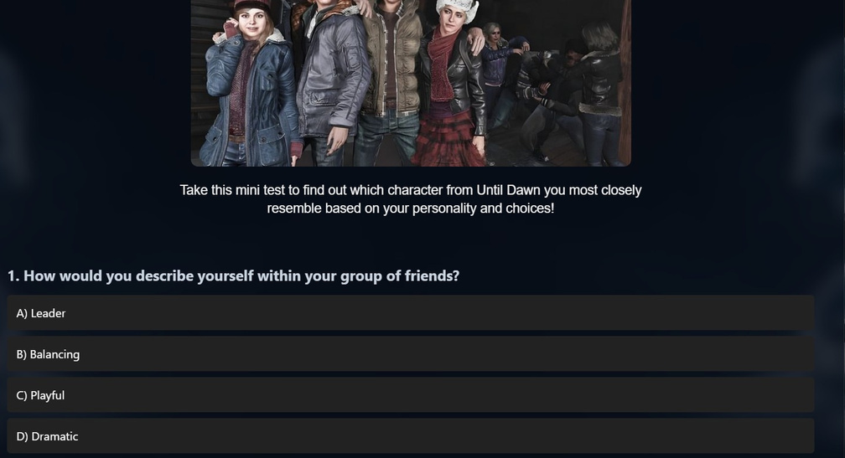
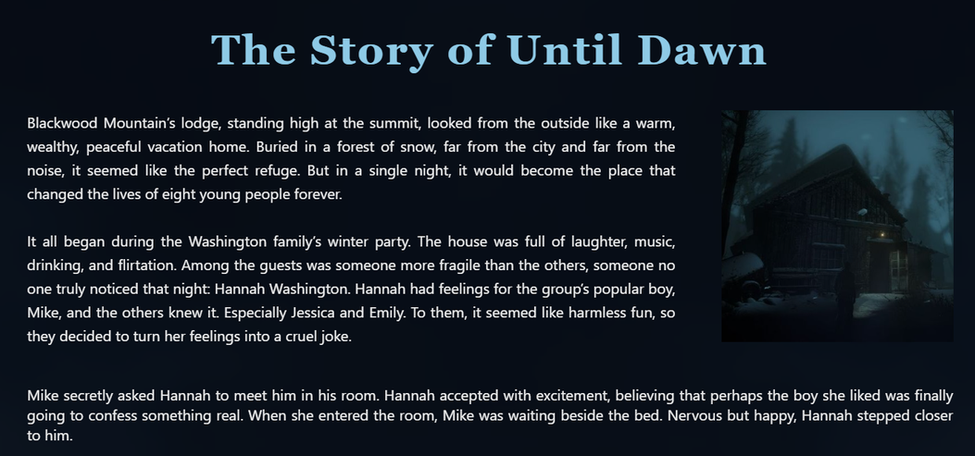
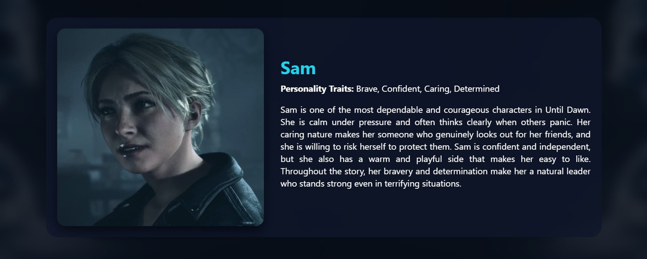
DEVELOPMENT PROCESS
Asset Optimization:
Carefully selecting and optimizing high-quality images and media to ensure the website remains atmospheric without compromising load times.

Slide 9
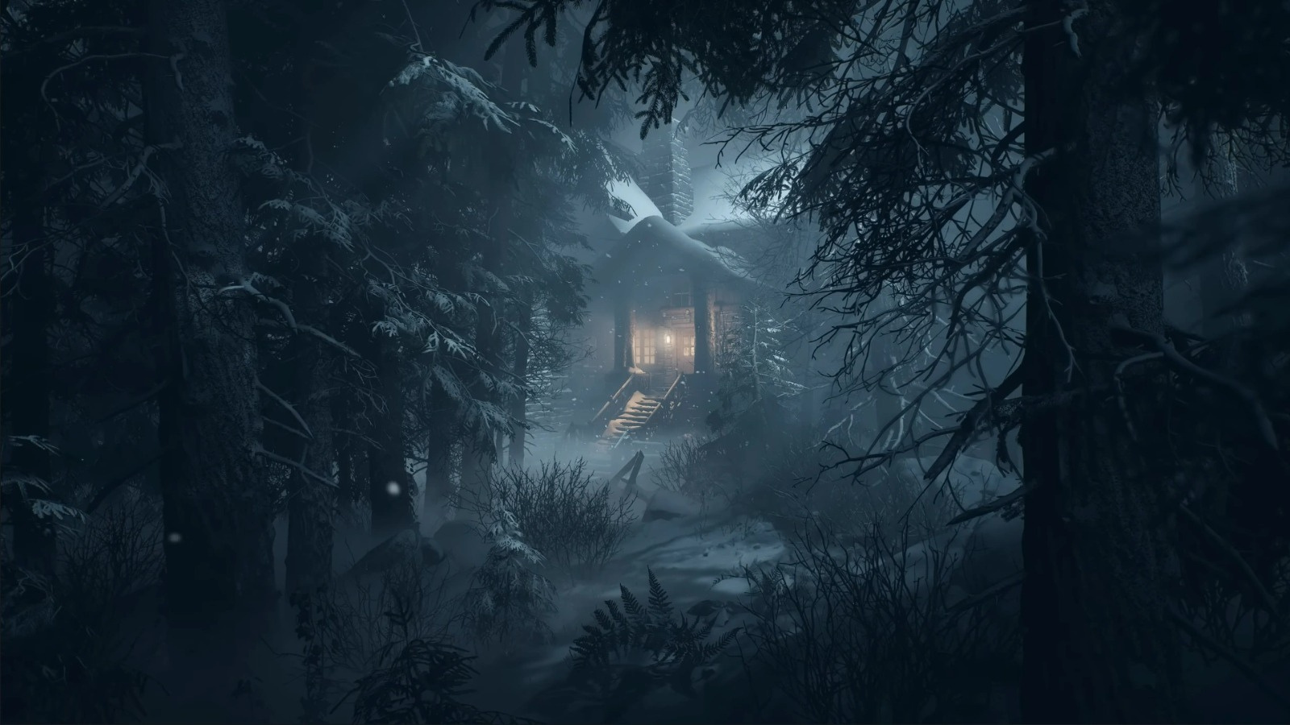
THANKS FOR LİSTENİNG

